Slide 1
EAP and Performance Management
Carrier Employee Assistance Program
Notes:
Carrier EAP Annual Report 2022

Slide 2
EAP as a Manager’s Tool
EAP Program Benefits assist with….
Enhancing positive supervisor/employee relationships.
Reducing employee health care costs and absenteeism
Retaining employees
Educating employees through relevant webinars and trainings
Supporting employees through a critical incident
Maintaining employee performance and productivity by offering a way for employees to address and resolve personal problems before they escalate. Employees who receive help can be restored back to expected levels of productivity with minimal disruption.

Slide 3
EAP Performance Management
In addition to providing valuable support to individuals and their families to address issues such as stress, relationships, depression or substance abuse, the EAP is an important resource for managers and supervisors. Available around the clock, EAP can provide management consultation related to:
Employee behavior changes
As a manager, you may witness a deterioration in performance or sense small behavior changes in an employee that, if left unchecked, could escalate. EAP has experts available to consult with you on how to identify a troubled employee and best refer them to your EAP.
Drop in performance
Sometimes performance declines to the point where a more comprehensive consultation with your EAP is appropriate. Not only can we help you in coaching the individual and documenting the performance problems and attempted resolution, EAP’s management consultants can guide you in talking to the employee and formally recommending that they contact your EAP.
Threat of violence
Violence in the workplace generally results from unresolved conflict that escalates out of control. EAP can assist you in dealing with troubled employees and resolving issues before they deteriorate into a potentially violent situation.

Slide 4
EAP Performance Management
When a team member is not meeting expectations, you need to
explain the gap between the desired result and what the employee has delivered
identify what needs to change, and the timeline for the employee to make that change
provide ongoing coaching, and arrange for additional training as needed
if appropriate, offer information about help available for personal issues through the employee support program
By managing performance well, you show that you care about all of your employees, and that you are committed to helping your team succeed. When you ignore performance problems or let them continue for too long, they can affect the morale of the entire team.

Slide 5
Signs of a Troubled Employee
Absenteeism
High accident rate
Difficulty with concentration
Erratic work patterns
Changes in personal health and hygiene
Sudden changes in mood
Poor interpersonal interactions
Confusion
Lowered job efficiency

Slide 6
Five-step process for managing employee concerns
STEP 1: Recognition
You have recognized a pattern of poor performance extending over a period of time. Inform the employee of the problem and allow some time for improvement. Be specific about the behaviors or performance issues that you have identified. It’s important to remain focused on the work performance problems.
STEP 2: Observation
This is the observation of the pattern of behavior and an exploration of its impact over time. When shared with the employee, this information will assist them in the problem-solving process.
STEP 3: Documentation
This involves keeping a written log of the observations made over time, which serves to help you and the employee see exactly what is going wrong.
STEP 4: Feedback
Using the information from the written log, the manager/supervisor presents it back to the employee. Then, with the employee, you help to define the specific problems.
STEP 5: Resolution
Use the documented information and discussion with the employee to develop a problem statement that will eventually lead to a resolution of the problem. That’s the ultimate goal—resolution of the problem. By working with the employee, you can look at possible options for solving the defined problem. Will additional training help? Is this a point where progressive discipline is needed? Would a referral to EAP help?

Slide 7
Supervisory Consultation Through EAP
Helps you prepare for session with employee
Reinforces and strengthens your skills
Provides emotional support
Clarifies the procedure for referring employee to the Employee Assistance Program
Assists in determining the appropriate type of EAP referral
Provides additional resources

Slide 8
Types of EAP Referrals
Management consultation: Beacon clinicians provide consultation related to employee behavioral concerns and demonstrated work performance issues (increased absenteeism, erratic work patterns, poor interpersonal interactions)
Informal Referral: A referral that is made when the worksite representative is concerned about an employee and is assisting the employee in accessing EAP services. Generally, there are no specific work performance issues that would warrant a formal referral. Informal referrals may also be referred to as “concern referrals.”
Formal Referral: A formal recommendation by the worksite representative for an employee to access EAP services with no potential job jeopardy for non-participation. Feedback is provided to the worksite representative regarding an employee’s participation with EAP recommendations with a ROI.
Mandatory Referral: A referral by a worksite representative for an employee with potential job jeopardy for non-participation. Feedback is provided to the worksite representative regarding an employee’s participation with EAP recommendations with an ROI.
Call 800-444-9559 to access these services

Slide 9
Informal Referral
When you notice a performance issue and either find out or suspect that a personal issue may be the cause (such as anxiety, dependent care, family conflict, or worry about financial or legal matters), you can help the employee by suggesting they contact the employee assistance program. This is called an “informal referral.” You are placing no obligation on the employee to follow up on your suggestion, though you should be clear about expectations for work performance.

Slide 10
Formal Referral
When you determine there is a personal issue affecting performance at work that must be addressed to comply with your organization’s rules and ensure safety in the workplace, or in order to meet performance expectations, you can go a step further and require the employee to contact and work with the employee support program. This is called a “formal referral.”
In most organizations, these steps align with the performance management process, including requirements that you document the issue and review it with the employee, making your expectations clear as to work performance and adherence to the rules of your organization. As an additional step, you will contact the employee assistance program about the issue, typically by submitting a release of information form with the employee’s name and the expectations for resolving the problem.
In a formal referral, the employee is required to contact the employee assistance program. Assuming the employee consents through a signed release of information form, the program reports back to the manager periodically to confirm whether the employee is complying with the action plan. The substance of the employee’s consultations with the employee assistance program are otherwise confidential.

Slide 11
Mandatory Referral
In the event of a positive drug screen, significant behavioral concerns, or an ongoing performance problem not resolved through previous efforts, depending on your organizational policy, you may make the employee’s involvement with EAP a condition of continued employment. You will be notified that the employee has contacted EAP and whether the employee has been compliant with treatment recommendations if the employee signs a release of information form.

Slide 12
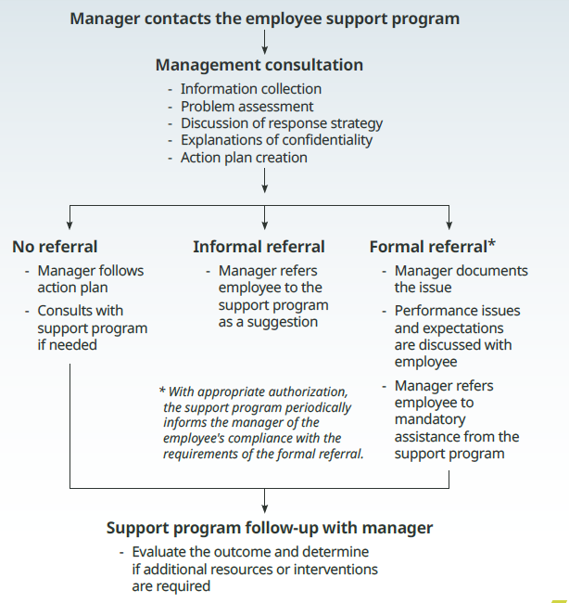
Process for Manager Consultation, Informal and Formal Referrals

Slide 13
Fitness for Duty Evaluation*
A Fitness for Duty Evaluation (FFDE) is an evaluation, requested by an employer, to determine if a current
employee is or is not able to function at the workplace because of psychological or psychiatric problems.
Employers have the responsibility to recognize when poor employee performance might be secondary to psychological conditions.
Employers request FFDEs when they suspect employees pose risks to themselves or others.
Employers should consider Fitness for Duty Examinations when they observe any of the following behavior from employees:
Threat of violence
Impaired concentration
Paranoid thinking
Abusive behavior toward co-workers or customers
Any behavior that poses a safety risk
*FFDE services can be coordinated through the EAP for an additional fee per the employer’s EAP contract

Slide 14
Tips for EAP Referral
Here are some ways to start a referral conversation
It sounds as though you have a lot on your plate right now.
Sometimes when there are physical problems it can effect how you are feeling as well.
You sound really down.
You sound really stressed.
I would like to ask you a couple of extra questions to get a sense of where you are currently.
It's not uncommon for people with an illness to be feeling unhappy or distressed. In order to help you access the care or resources you may need, do you mind if I ask you a few questions about how you've been doing in the past month?

Slide 15
Carrier Employee Assistance Program
A confidential employee counseling and engagement process
No cost
Employee and all household members are eligible
Member EAP access available [ 24/7/365 ] at 866-984-3110
Staffed by licensed, masters level clinicians available to assess issues and refer participants to the most appropriate resource based on individual need.
EAP addresses quality of life issues – any area of concern
Work/Life and Legal & Financial Referrals
Sessions offered face-to-face (office), telephonic, or video enabled telehealth
EAP website – www.carelonwellbeing.com/carrier
Manager’s Workplace Consultation line at (800) 444-9559

